Slide 1
Building Full Lives
Moving in a New Direction

Slide 2
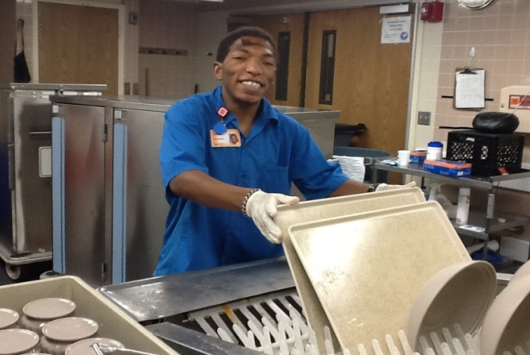
What is a Full Life to YOU?
What is a Full Life to the individuals we support?
What steps do we need to take to help our organizations move in a new direction?
Notes:
10 –minutes Ice Breaker

Slide 3
Goodwill SE Wisconsin
Our Transformation Timeline
2013
Strategic transformation begins
Communication begins
2014
Fast growth in Supported Employment
2015
Individuals start to transition
2016
Begin piloting new services
Minimum wage implemented
2017
Restructure team
Work center model ends
Hire participants as employees
2018
Launch EmpowerOne
Now the rebuilding truly begins!

Slide 4
Easterseals SE Wisconsin
What did our journey look like:
Over 50 Years of Facility Based Prevocational Services due to a merger with the Waukesha Training Center
2015 Developed the Program Expansion Committee to focus on growth with the programs that focused on community and skill building.
2016 Examined Current Programs, Capacity and also the aging population that we were serving in some area.
2017 Made announcements about future program.
December 31st, 2018 we will have transition out of facility based prevocational programing
Where are we today
We are working to education/inform individuals, families and funders about options to achieve goals.
We are developing plans for each individuals that we serve
We are developing plans for the business that we partner with
Notes:
5 – 10 minutes

Slide 5
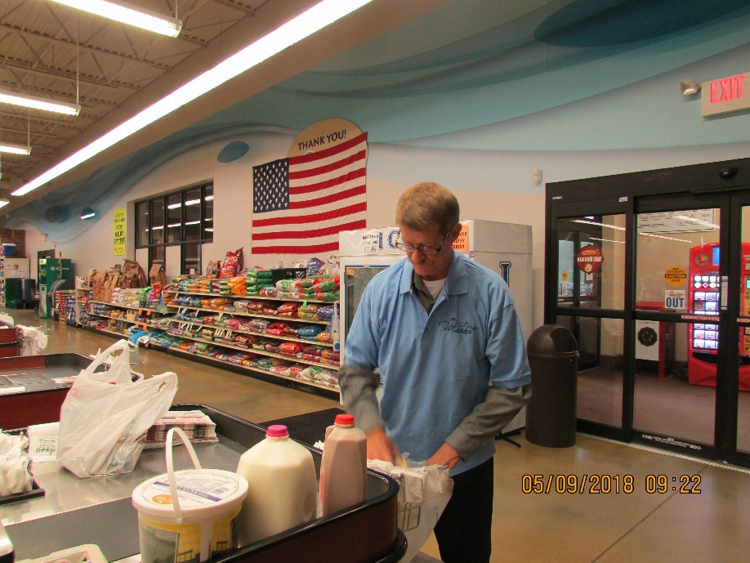
Bethesda
What did our journey look like:
Long history of residential services-114 years
Almost 50 years of having a sheltered workshop setting
Services of work center and facility based day program created to supplement those in residential services during the day
Where are we today
Currently operate facility based day program, facility based sheltered workshop and community based supported employment
Moving Forward: Expectation is that August 30, 2019 is last day that we will have the sheltered workshop setting
New model is Community Based Supported Employment, Community Based Customized Employment, Career Center and Project SEARCH which are all under Career Connections.
Along with Facility Based day program, Community Based day program, Senior Connections and Trip and Travel which are all under Community Connections.

Slide 6
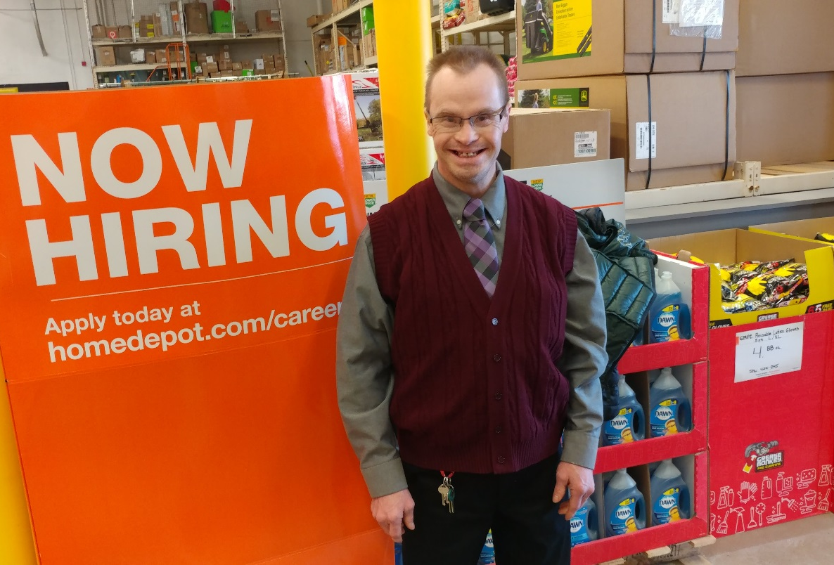
Are You Moving in a New Direction? What does your Journey look like?

Slide 7
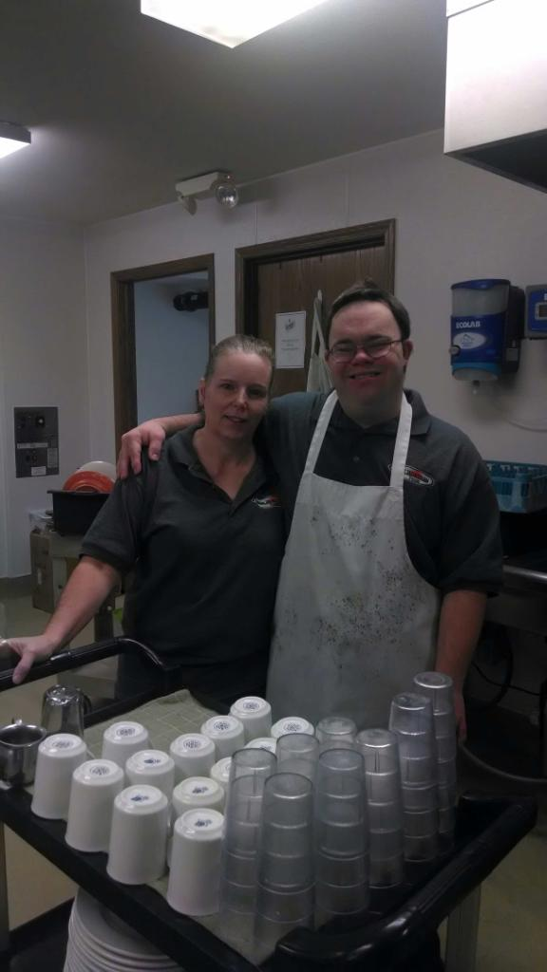
Moving in a New Direction Key Decision Factors
Federal and state laws emphasize community employment and integrated services.
Service preferences have shifted for students exiting schools. Integrated life and community jobs are expected.
Employers are more educated and open to the benefits of hiring individuals with disabilities.
Notes:
Beth
How to relay that message?
Do all organization have to follow the Federal/State Laws.
Kristine
Schools are experience nitrated education- so it is away of life
Molly
List employer that are coming to the table – Project SERACH , BAC (list who they are and how they come to the table),
Multiple hires in an organization. Walgreens/Meier/Planet Fitness/Marriott– seeing and recognizing untapped pool

Slide 8
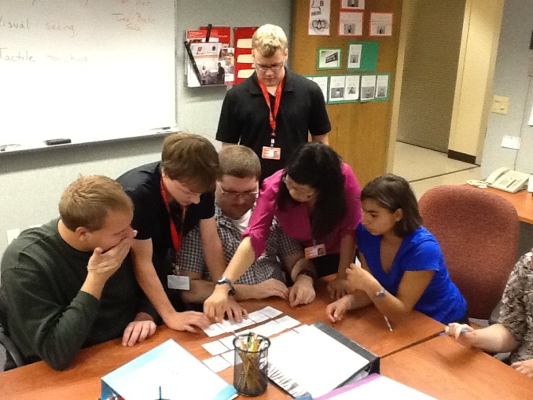
Moving in a New Direction Core Components for Organizational Change
Commitment from the Top-Down within the Organization from Board and Leadership to Team members.
Development of a Communication Plan that addresses the needs of individuals, families, staff and funders.
Development of New or Expanded Services for individuals to transition into to further skill development and get into employment.
Notes:
Difference at each organization – each share what it looked like
Communicaiton Plan – each share what we did. Simple message for staff (elevator Speech)
3. Why is it important to have services ahead of time to ensure a smooth transition . Each share - How to look a the current population you serve and develop program related to the needs. List the service that we have created new and expanded.
- Exposure preceeds interest
- Interest preceeds motivation.
Intended to increase a person’s independence and participation in community life.
Instructional and focused on skill development in a variety of areas including (but not limited to):
routine daily activities,
skills needed to access and use of community resources,
money management,
home care maintenance,
food preparation,
mobility training, and
self-care skills.

Slide 9
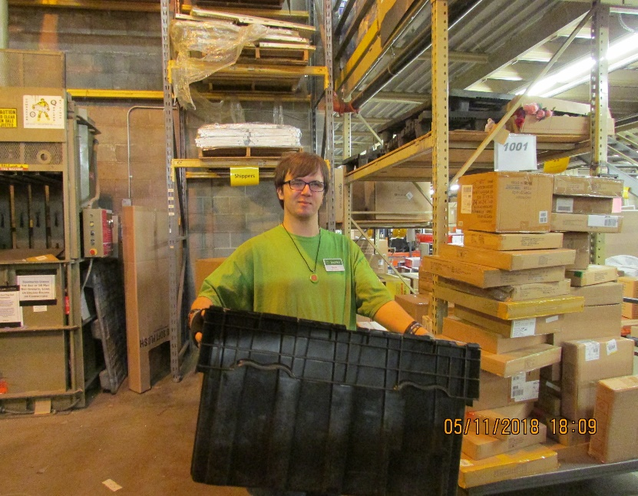
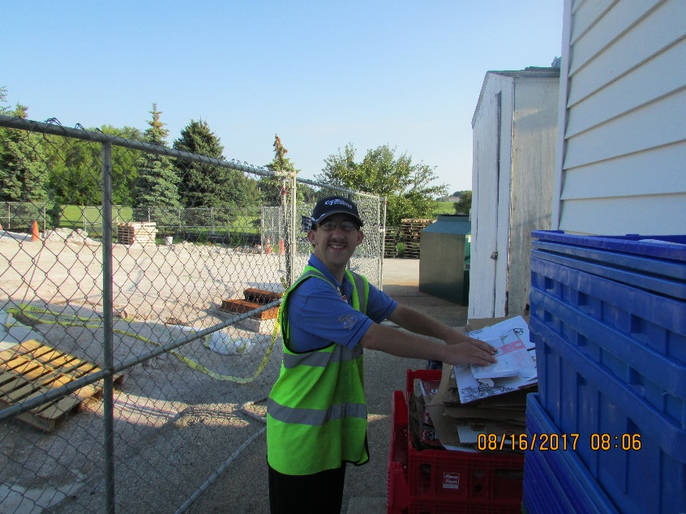
Moving in a New Direction Our Challenges
Internal culture shift for staff, families and individuals. Stepping out of the old and into the new.
Dealing with uncertainty and unknown as we move forward.
Dealing with a complex and emotional journey for everyone.
Notes:
1. Molly -
2. Molly
3. Molly /Beth
4. Beth - think about transportion.
5. Kristine - Cascading impact on shared supports around the person and working collaboratively. Group home,transportations.

Slide 10
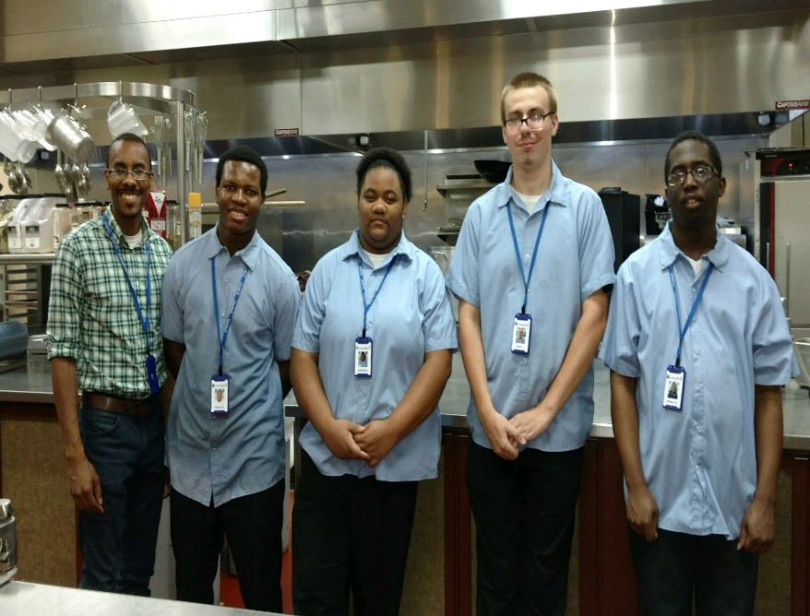
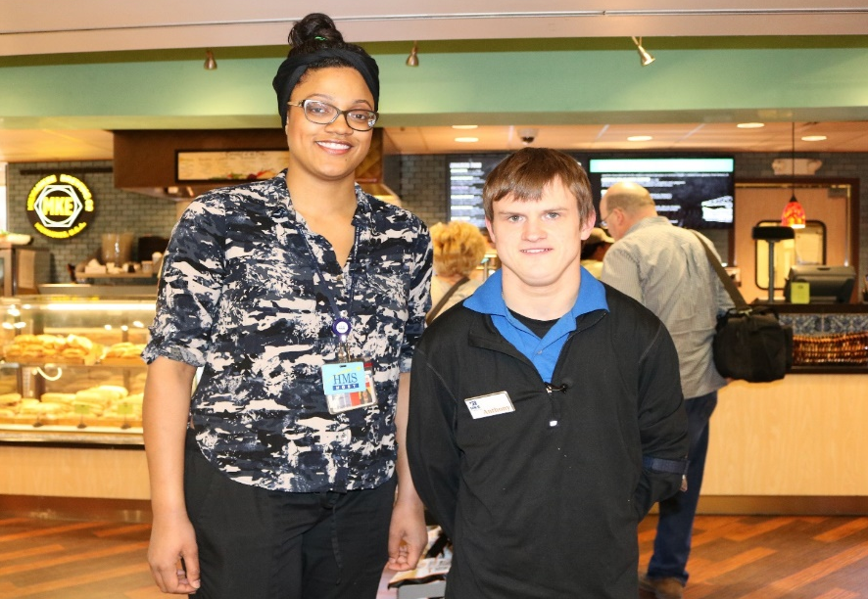
Moving in a New Direction Our Challenges
Funding sources supporting integrated employment but not always reflective in funding available.
Cascading impact on shared supports around the person and working collaboratively.
Notes:
1. Molly -
2. Molly
3. Molly /Beth
4. Beth - think about transportion.
5. Kristine - Cascading impact on shared supports around the person and working collaboratively. Group home,transportations.

Slide 11
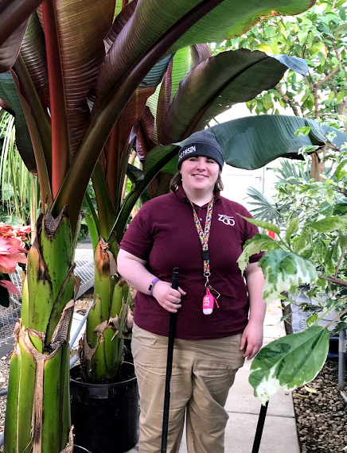
Moving in a New Direction Our Successes
More and more individuals are obtaining jobs in the community and gaining real experiences.
There are more opportunities to explore within the community to help us learn about individuals. The community is fresh, real and dynamic every day.
We see relationships shift from paid staff to those within an individual’s expanded community.
Notes:
Each share one story to reflect on the above statements
1.
2.
3.
4.
5

Slide 12
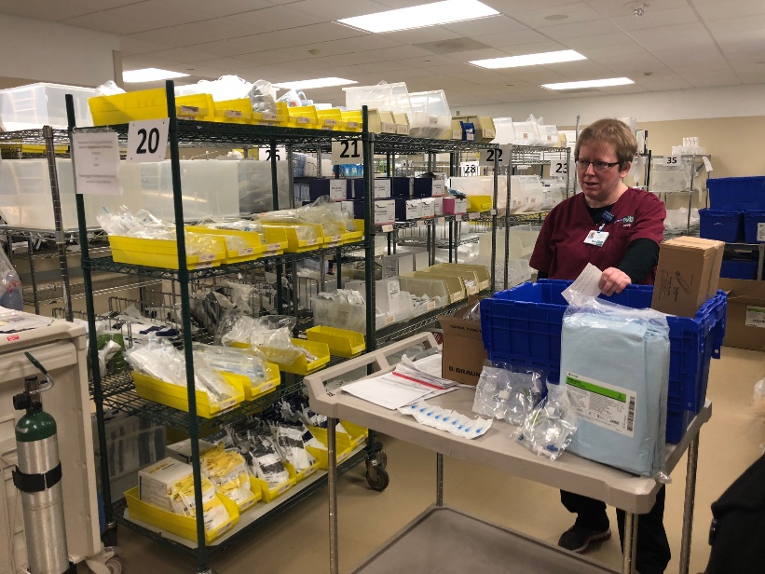
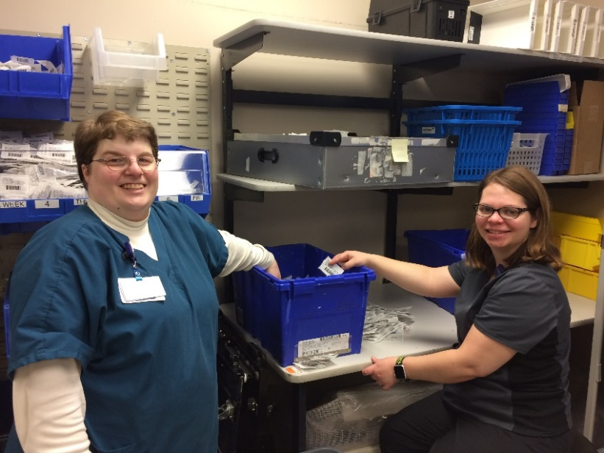
Moving in a New Direction Our Successes
We are listening more to each individual and getting better at realizing what life they want to live.
Family, individuals and the community’s perceptions of what is possible is starting to change.
Notes:
Each share one story to reflect on the above statements
1.
2.
3.
4.
5

Slide 13
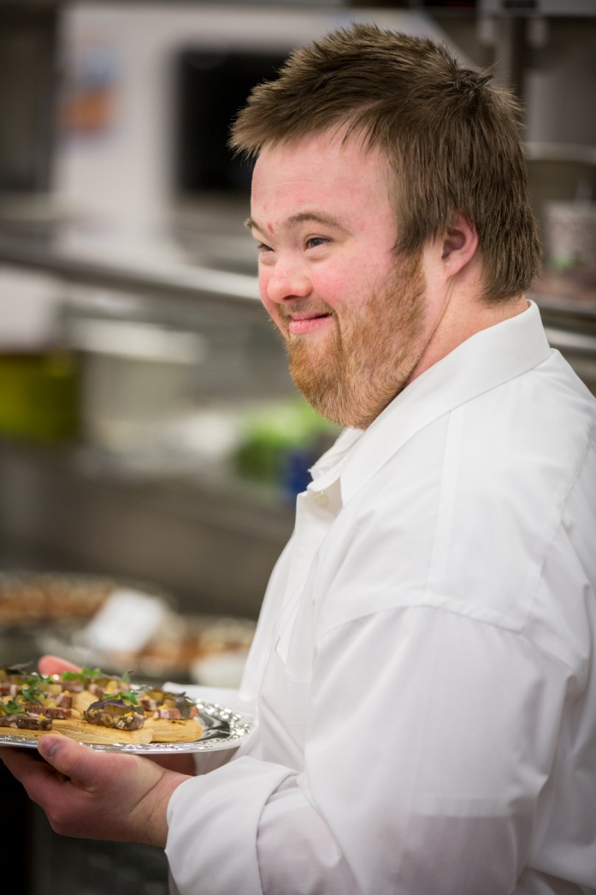
Moving in a New Direction Strategies
Deliberate, thoughtful, person-centered approach for people’s futures. Ensuring well-coordinated communications.
Keep empathy at the forefront of dialogue and actions.
Creation of plans that assist throughout the changes being made.
Notes:
1. Beth
2 .Beth
3. Molly - Creation of plan - all share idea. - needs to have project management
- communication
- fluid planning - adjust as you go.
- program develpment
4. Kristine – from facilty base interaction to community based interaction, systematic instruction
5. ALL - What does this look like
- Rate of the MCO’s

Slide 14
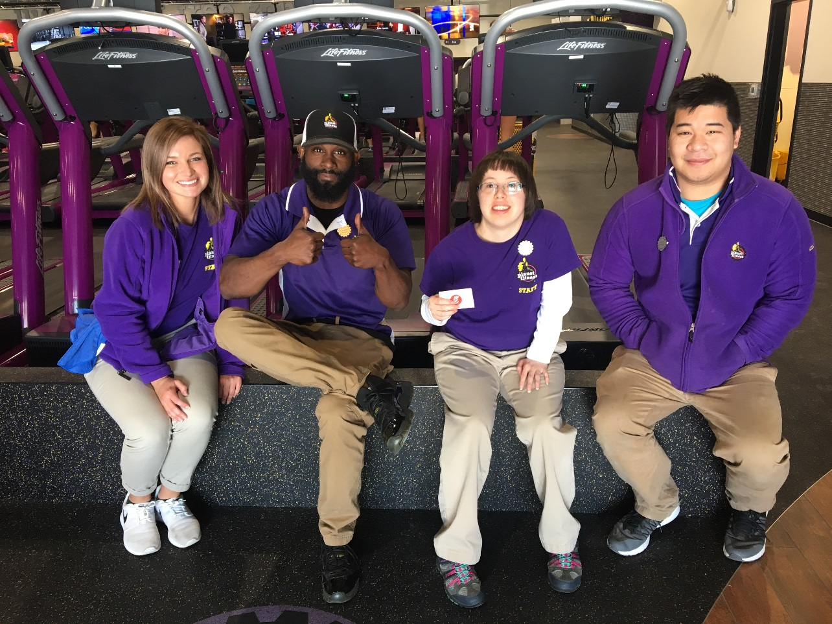
Moving in a New Direction Strategies
Offer training that may be needed for staff and invest to transform and prepare for new roles.
Collaboration and best practice sharing to support change and celebrate the successes.
Notes:
1. Beth
2 .Beth
3. Molly - Creation of plan - all share idea. - needs to have project management
- communication
- fluid planning - adjust as you go.
- program develpment
4. Kristine – from facilty base interaction to community based interaction, systematic instruction
5. ALL - What does this look like
- Rate of the MCO’s

Slide 15
What is a Full Life to YOU?
What is a Full Life to the individuals we support?
What steps do we need to take to help our organizations move in a new direction?
Notes:
Ice Breaker

Slide 16
Molly Gilgenbach Director of EmpowerOne Molly.Gilgenbach@goodwillsew.com Beth Andrea Lohmann Director of Employment and Community Services bethl@eastersealswise.com Kristine Leonard Senior Director of Program Development Kristine.leonard@BethesdaLC.org

